Slide 1
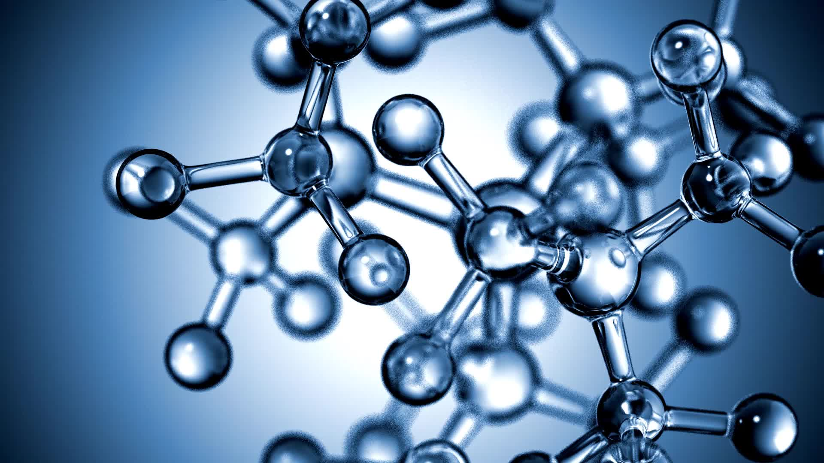
Similarity SMC
أنس عبدالله الذارعي

Slide 2
Distance Measures in Machine Learning
Find the distance between two objects represented by attribute values X = (1, 0, 0, 0, 0, 0, 0, 0, 0, 0)
and Y = (0, 0, 0, 0, 0, 0, 1, 0, 0, 1)

Slide 3
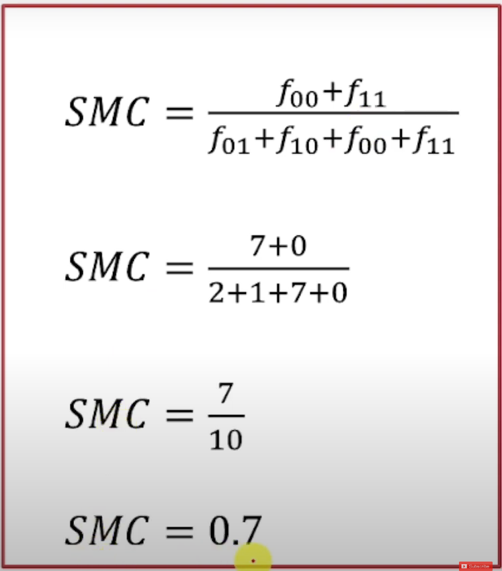
Simple Matching Coefficient (SMC)
X = (1, 0, 0, 0, 0, 0, 0, 0, 0, 0) and
Y = (0, 0, 0, 0, 0, 0, 1, 0, 0, 1)
F01 → Value of x is 0 and y is 1 = 2
F10 → Value of x is 1 and y is 0 = 1
F00 → Value of x is 0 and y is 0 = 7
F11 → Value of x is 1 and y is 1 = 0

Slide 4
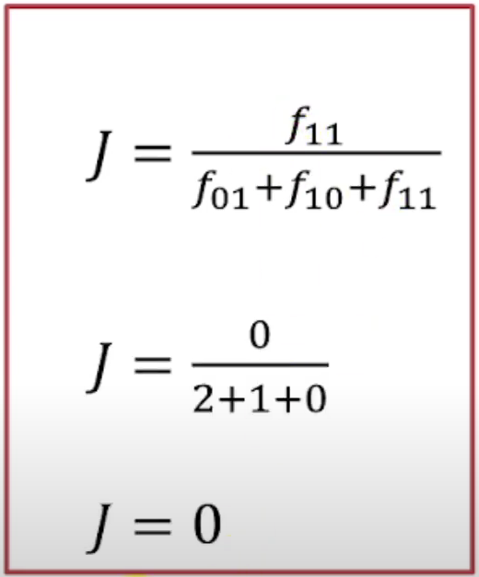
Jaccard Coefficient
X = (1, 0, 0, 0, 0, 0, 0, 0, 0, 0) and
Y = (0, 0, 0, 0, 0, 0, 1, 0, 0, 1)
F01 → Value of x is 0 and y is 1 = 2
F10 → Value of x is 1 and y is 0 = 1
F00 → Value of x is 0 and y is 0 = 7
F11 → Value of x is 1 and y is 1 = 0

